Slide 1







ClinixBot
Empowering Health Decisions with
CLINIXBOT
App
An AI-Assisted Multilingual Medical Diagnostic Tool
Presented by:
Tianlun Li, Adeline Miao, Qixuan Zhang, Xinyi Xu
CLINIXBOT
APP
Notes:
Welcome to our presentation on ClinixBot – a multilingual AI-powered healthcare assistant designed to support early medical decision-making.
Our title reflects our mission: Empowering smarter health decisions.
ClinixBot helps users—patients, caregivers, even clinicians—make sense of symptoms quickly and responsibly. Today, we’ll show you how.”

Slide 2



ClinixBot
Reimagining Patient Engagement
in Primary Care
ClinixBot is an AI-powered, multilingual chatbot designed to assist users with early health decisions through a friendly, conversational interface.
It provides:
AI-driven symptom interpretation
Preliminary diagnosis
Medication guidance
Nearby hospital and pharmacy locators
Interactive health data visualizations
Our vision is to democratize healthcare information access, reduce unnecessary ER visits, and support smarter triage at the community level.
Built with GPT-4 Turbo and LangChain RAG, it supports Chinese version and English,
improving accessibility for diverse populations.

Slide 3


ClinixBot
The Healthcare Access & Decision Gap
Millions delay or avoid care due to cost, confusion, or language barriers.
70%+ of intusers search symptoms online, but results lack clinical context or personalization.
Overburdened healthcare systems struggle with initial triage, especially in under-resourced settings.
ClinixBot addresses these issues by offering:
Safe, AI-supported pre-diagnostic guidance
Multilingual dialogue and easy navigation
A platform for both public and professional adaptation

Slide 4
ClinixBot
WHO IS OUR USER
About
Stakeholders
Target Users
Patients with limited health literacy or facing non-urgent but concerning symptoms
Caregivers supporting dependent family members through early health decisions
Primary Care Clinics and GPs experiencing high patient volumes and triage bottlenecks
Core Stakeholders
General Public — especially linguistically or digitally underserved populations
Healthcare Providers — clinicians, nurses, and outpatient triage staff
Digital Health Innovators — startups and platforms seeking AI-enhanced engagement
Public Health Entities — focused on equitable access and preventive interventions
CLINIXBOT
APP

Slide 5


ClinixBot
Home
About Us
Service
Contact
AI
Problem Formulation
Primary Challenge: Map symptom descriptions
→ potential medical conditions
Target Variable: Medical condition diagnosis (categorical)

Slide 6

ClinixBot
Home
About Us
Service
Contact
AI
Problem Formulation
Task | Description | Application in ClinixBot
Natural Language Processing | Extract medical information using OpenAI API | Chat diagnosis feature
Retrieval-Augmented Generation | Find similar cases in medical database | RAG model functionality
Fine-tuning | Customize model on medical data | Improved diagnostic accuracy
Geospatial Analysis | Identify nearby healthcare facilities | Hospital & pharmacy finder
Notes:
The core AI challenge for ClinixBot is mapping symptom descriptions to potential medical
conditions. This is a classification problem where our target variable is the medical condition
diagnosis, which is categorical variable.

Slide 7


ClinixBot
Home
About Us
Service
Contact
Dataset
Description
Dataset Structure
Patient ID & Name (identification)
Date of Birth & Gender (demographics)
Medical Condition (diagnosis)
Treatments (interventions)
Doctor's Notes (clinical observations)
Admit Date & Discharge Date (hospital stay)
Bill Amount (financial data)
Notes:
We used four tools to make this happen:
• First, we use the OpenAI API for natural language processing to extract key medical
information from user descriptions, to understand what people say about their symptoms.
• Second, we use Retrieval-Augmented Generation (RAG) to find similar cases in our medical
database, providing reference points for diagnoses. like how doctors remember similar
patients.
• Third, we've implemented a fine-tuning capability that allows customizing the model on
medical data, improving accuracy of diagnosis. so it gets better and better at guessing what
sickness someone might have.
• We also have a map feature that helps people find the closest hospitals and pharmacies when
they need them.

Slide 8

ClinixBot
Home
About Us
Service
Contact
Data
Preparation
Missing Value Handling
Numeric columns: Filled with median values
Categorical columns: Filled with mode (most frequent value)
Date Standardization
Conversion of string dates to datetime objects
Calculation of stay duration from admit/discharge dates
Text Normalization
Lowercase conversion of medical conditions and treatments
Whitespace standardization in text fields
Feature Engineering
Age calculation from date of birth
Age group categorization
Primary treatment extraction from treatment lists
Database Structuring
User data, chat history, and diagnosis records stored in SQLite
Ensures data persistence and retrieval capabilities
Notes:
ClinixBot learns from 1,000 real patient records from 2021 to 2024.
The dataset has a comprehensive structure with seven key fields:
• Patient ID and Name for identification;
• Date of Birth and Gender;
• Medical Condition documenting formal diagnoses;
• Treatments recording interventions;
• Doctor's Notes containing clinical observations;
• Admit and Discharge Dates When they went to the hospital and when they left;
• and Bill Amount reflecting financial data.

Slide 9
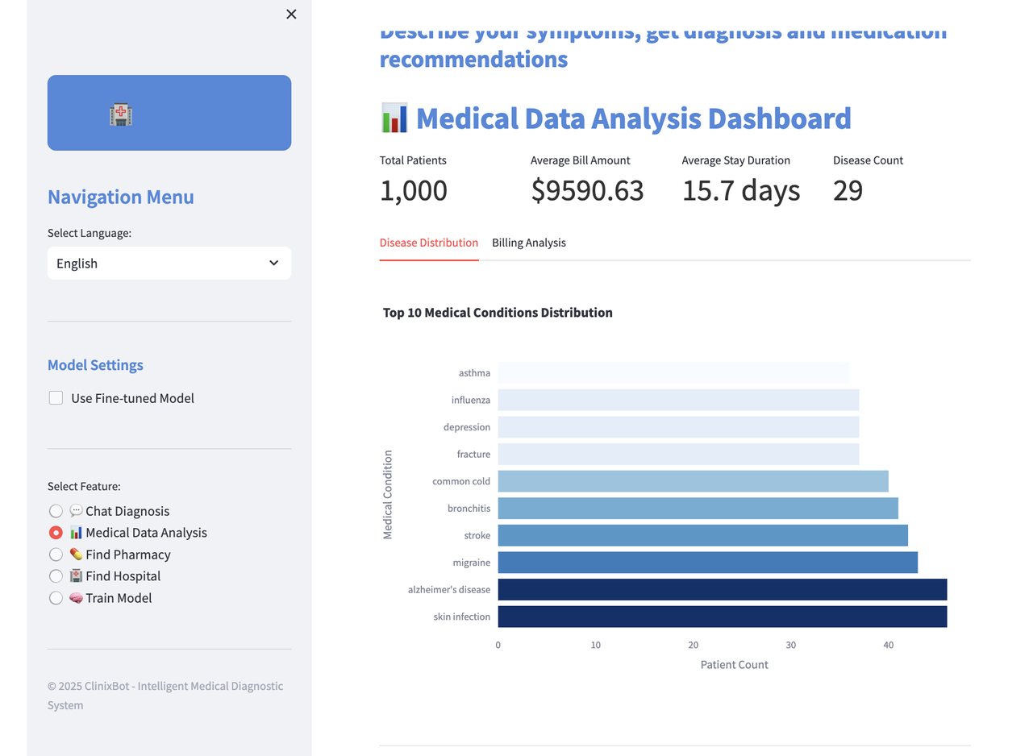
ClinixBot
Home
About Us
Service
Contact
Exploratory Data Analysis
Most common conditions include:
Skin infection
Alzheimer’s disease
Migraine
Stroke
Bronchitis
“Should we allocate more resources or attention to conditions with higher volume in training and evaluation?”
Notes:
To enable effective learning by our AI models, we've conducted systematic data preparation:
• For missing value handling, we used the median number for number fields and the most
frequent value for categorical fields.
• For date standardization, We fixed all the dates so the computer could understand them and
figure out how long people stayed in the hospital.
• We made all the text simple for the computer by making everything lowercase and fixing extra
spaces.
• We also created new helpful information, like figuring out each person's age from their
birthday and grouping them by age.
• Finally, we've established an SQLite database structure to store user data, chat history, and
diagnosis records, so we can easily find any information we need later.

Slide 10
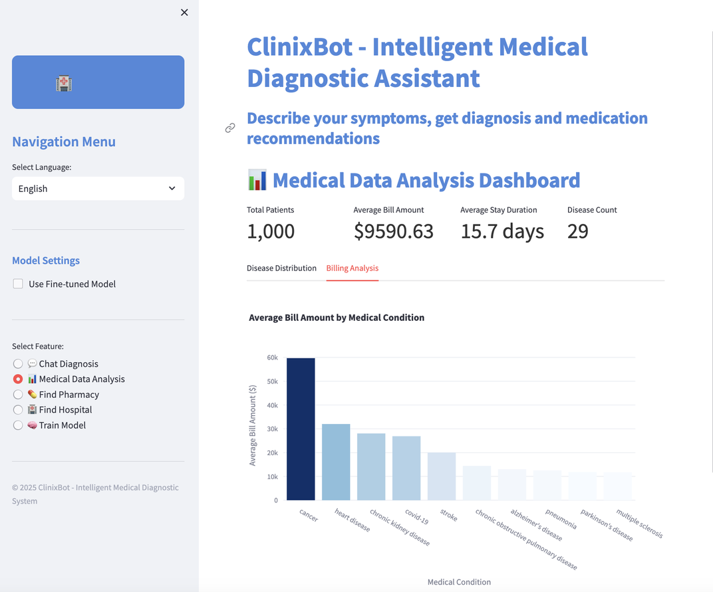
ClinixBot
Home
About Us
Service
Contact
Exploratory Data Analysis
Highest average billing conditions:
Cancer (~$58,000)
Heart disease (~$32,000)
Chronic kidney disease, COVID-19, Stroke (~$28,000–$20,000)
“Is the fine-tuned model better at diagnosing high-cost conditions?”
“Is there a correlation between diagnostic accuracy and billing impact?”

Slide 11
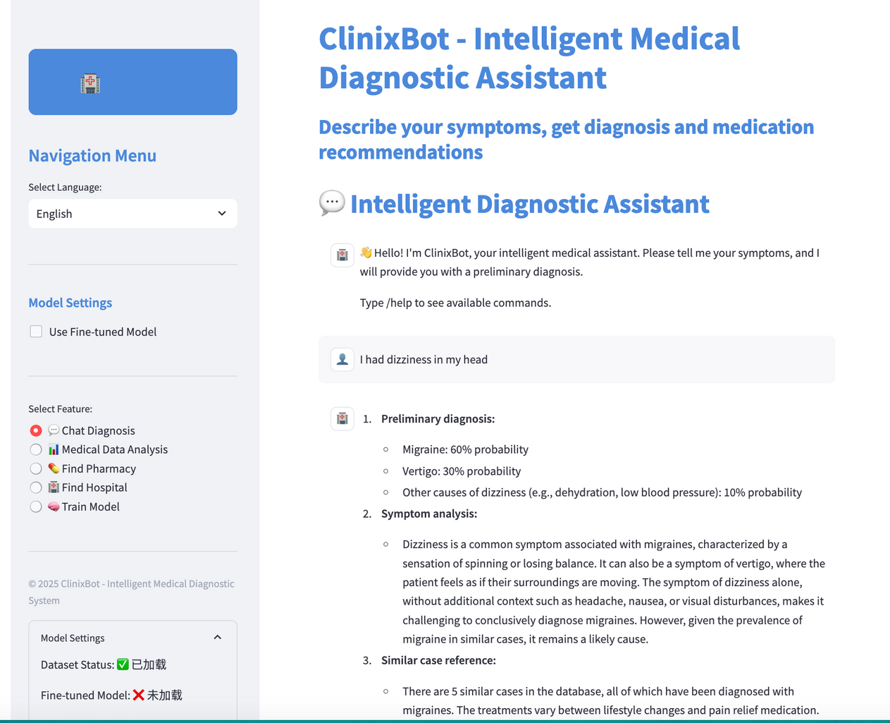

ClinixBot
Home
About Us
Service
Contact
AI Modeling
🔍 Retrieval-Augmented Generation (RAG)
Workflow:
User inputs symptoms
System retrieves relevant medical documents from a vector database using embeddings
Combines:
Retrieved context
Similar case statistics
User query
Passes combined info to a base GPT-4 model with a structured prompt
GPT generates diagnosis & treatment plan based on real data

Slide 12
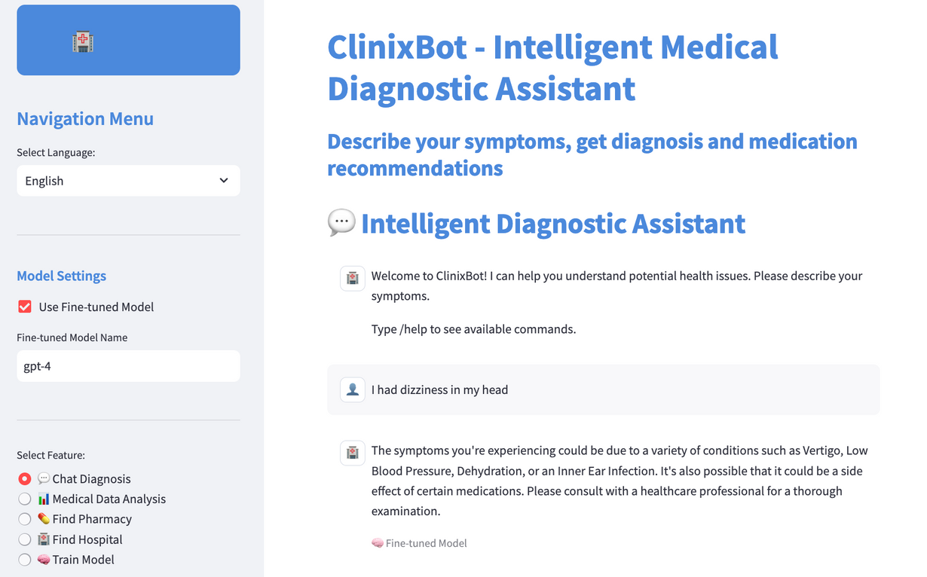
ClinixBot
Home
About Us
Service
Contact
AI Modeling
🎯 Fine-Tuned Model
Workflow:
Model trained on labeled data (symptoms → diagnosis & treatment)
Learns to respond end-to-end without external document lookup
At inference:
User inputs symptoms
Model directly generates diagnosis based on learned patterns

Slide 13
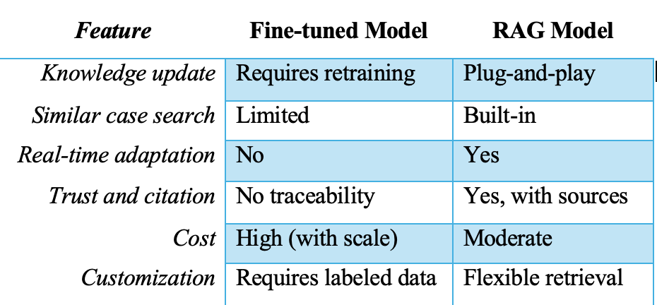
ClinixBot
Home
About Us
Service
Contact
AI Evaluation
1. Real-Time Access to Clinical Knowledge
RAG pulls updated information from an external medical knowledge base (e.g., clinical guidelines, case libraries).
Unlike fine-tuned models which are fixed post-training, RAG can dynamically retrieve relevant data (e.g., current migraine treatment protocols or similar patient cases).
2. Better Explainability and Traceability
In the example, ClinixBot provides:
Diagnosis probabilities
Similar case counts
Recommended exams and medications
RAG allows the model to cite or trace back to medical records or studies, enhancing clinician trust and auditability.
3. Reduced Need for Costly Fine-Tuning
RAG lowers costs by avoiding expensive, repeated fine-tuning every time the knowledge base changes.
For example, updates to hypertension or vertigo treatment guidelines can be added to the database without retraining the model.

Slide 14


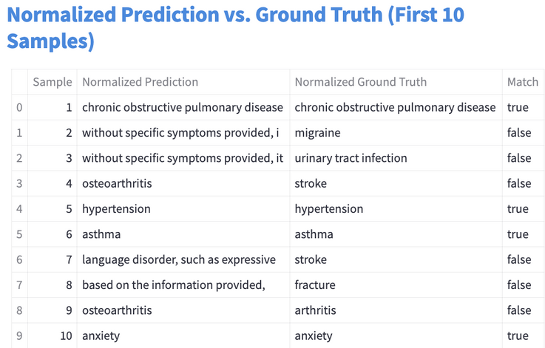
ClinixBot
Home
About Us
Service
Contact
AI Evaluation
Our evaluation framework carefully compares normalized predictions against normalized ground truth to provide meaningful metrics about the model's diagnostic capabilities while accounting for terminological variations.
Source of Ground Truth: The ground truth values are directly extracted from the CSV file's "Medical Condition" column:
Normalization Process: The model normalizes both the predicted conditions and ground truth values using the _normalize_condition method:
The Normalization Logic: The normalization function standardizes medical terminology through several steps:
Converting to lowercase
Removing common prefixes and suffixes
Standardizing medical terminology variations (e.g., "diabetes mellitus type 2" to "type 2 diabetes")
Truncating to the first 5 words if the condition is too long
Most mismatches stem from:
Outputting symptoms instead of conditions
Using non-committal or vague language
Formatting issues or incomplete strings
Not using ontology-based equivalence (e.g., arthritis vs. osteoarthritis)

Slide 15
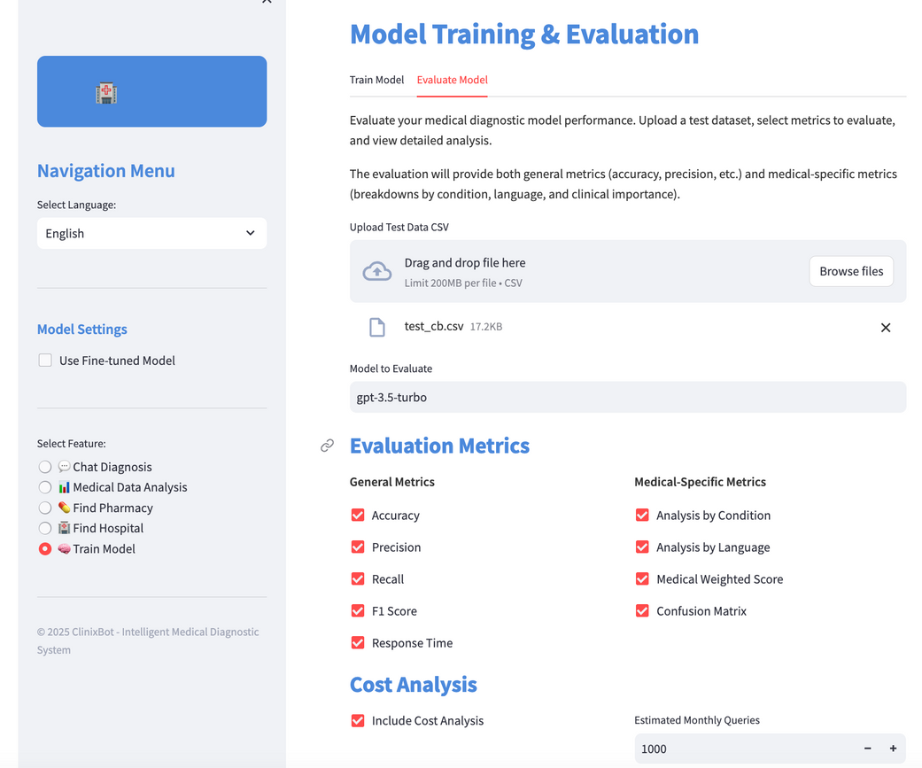
ClinixBot
Home
About Us
Service
Contact
AI Evaluation
Evaluation Metrics
Divided into two categories:
✅ General Metrics
Accuracy: % of exact diagnosis matches.
Precision: % of relevant predictions among those made.
Recall: % of true conditions that were correctly predicted.
F1 Score: Harmonic mean of precision and recall.
Response Time: Average time taken per prediction.
⚕️ Medical-Specific Metrics
Analysis by Condition: Breakdown of accuracy by each disease.
Analysis by Language: Compare performance across languages (e.g., English vs. Chinese).
Medical Weighted Score: Accuracy weighted by clinical severity.
Confusion Matrix: Visualization of true vs. predicted diagnoses.
💵 Cost Analysis
Include Cost Analysis (checkbox): When enabled, estimates token-based costs.
Estimated Monthly Queries: Set volume to calculate projected cost. Currently set to 1,000 queries.

Slide 16
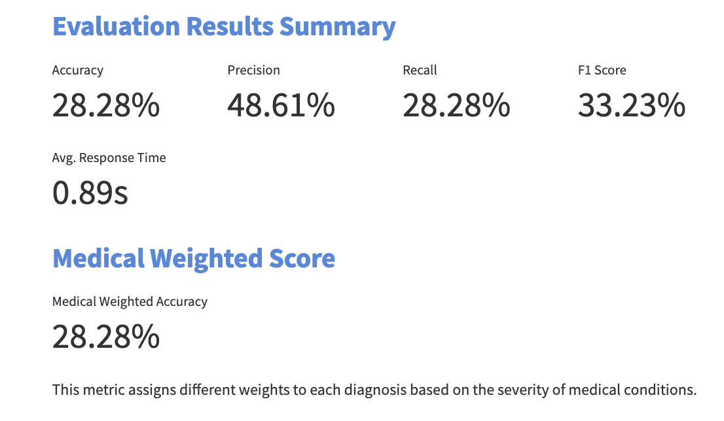
ClinixBot
Home
About Us
Service
Contact
AI Evaluation
Low accuracy is expected in open-ended generation tasks like diagnosis prediction, where lexical mismatch (e.g., “heart attack” vs. “myocardial infarction”) can lead to false negatives.
The model often outputs descriptive language or partial symptoms instead of a clear condition label.
The model fails to identify true diagnoses in a large portion of cases, likely due to:
Ambiguous or overly generic outputs (e.g., “the condition is unclear”)
Symptom-focused responses instead of naming conditions
Avg. Response Time (0.89s):
Indicates high efficiency, with responses delivered in under 1 second on average.
This responsiveness is suitable for real-time clinical triage support, even if the accuracy is still improving.

Slide 17


ClinixBot
Home
About Us
Service
Contact
Conclusion &
Recommendations
KEY ACHIEVEMENTS
Provides structured, reasoned analysis of user-reported symptoms
Offers clear visualizations of health trends and healthcare costs
Delivers practical location-based services to find hospitals and pharmacies
Includes a model training feature for continuous improvement and customization.
Notes:
ClinixBot does exactly what we set out to do:
- It assists users in understanding their symptoms with clarity and structure.
- It simplifies health trends and cost data through effective visual tools. and it helps people to quickly locate nearby hospitals and pharmacies, which is incredibly practical.
Additionally, we have incorporated a training feature that allows the model to enhance its performance over time continually.

Slide 18

ClinixBot
Home
About Us
Service
Contact
Conclusion &
Recommendations
KEY INSIGHTS
Balanced Information Approach - Combine AI insights with clear disclaimers
Cost-Condition Correlation - Stress the need for early diagnosis to reduce high-cost conditions
User Guidance Improvement - Keep improving follow-up questions for clearer user input
Localization Value - Provide useful local healthcare recommendations
Data Expansion Focus - Expand the dataset to cover rare conditions
Notes:
From our analysis, we extracted several significant insights:
- Firstly, we learned that it’s crucial to balance helpful AI insights with clear reminders that this isn’t a replacement for a real doctor.
- Second, the data showed just how much early diagnosis and preventive care matter. This is especially true for expensive conditions like cancer, where catching it early can massively cut down on costs and improve outcomes.
- Third, we realized we can make the system even better by improving the follow-up questions.
So going forward, we should really focus on gathering more relevant, detailed information from users through these targeted follow-ups.
- Fourth, we saw that the New Haven location services are working well — they show the system’s ability to provide healthcare recommendations that are actually useful and relevant to where people live.
- And finally, the data made it clear that expanding our dataset will be key.
By adding more cases, especially rarer conditions, we can boost our diagnostic accuracy and make the system even more reliable.

Slide 19
ClinixBot
Home
About Us
Service
Contact
Next
Steps
Several key enhancements
Expand medical database for broader diagnostic coverage
Refine models by combining RAG and fine-tuned approaches
Add multi-language support for diverse users
Develop a mobile app for better accessibility
Enhance data privacy protections
CLINIXBOT
APP
Notes:
While the current model works really well, we’ve identified several key improvements that can make ClinixBot even stronger.
- First, we’re planning to expand the medical database so the system can cover a much broader range of conditions — including some of the rarer ones we’re missing now.
- Next, we want to keep refining the models themselves, maybe by combining the strengths of the RAG approach with the fine-tuned models, so we get the best performance possible.
- For now, we only have two kinds of language, English and Chinese, so we also aim to add multi-language support, so we can serve a wider, more diverse group of users and make the system truly global.
- Another step is developing a mobile app, which will make ClinixBot even more accessible and convenient to use.
And of course, as we continue to grow, we’re putting a big focus on strengthening data privacy, because protecting user trust is absolutely essential for everything we do.

Slide 20
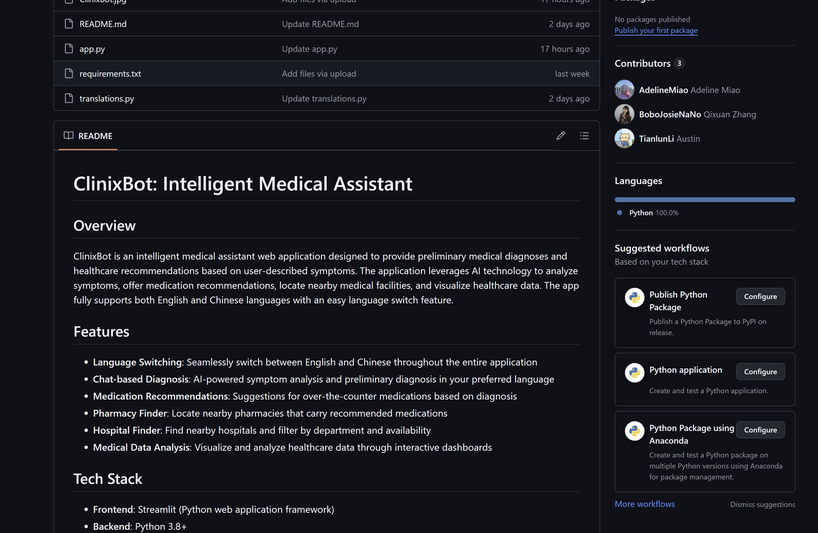

ClinixBot
Home
About Us
Service
Contact
Thank
You
VISIT OUR GITHUB PAGE TO LEARN MORE：HTTPS://GITHUB.COM/ADELINEMIAO/CLINIXBOT

